Slide 1

Balance of Payments
4.6
Copyright Bananaomics

Slide 2

Definition
Balance of Payments (BOP)
A record of the value of all transactions of a country with the rest of the world over a period of time
BOP keeps track of a country's money inflow and outflow.
Copyright Bananaomics

Slide 3


Main Components
Capital Account
BOP
Current Account
0
Financial Account
Copyright Bananaomics

Slide 4
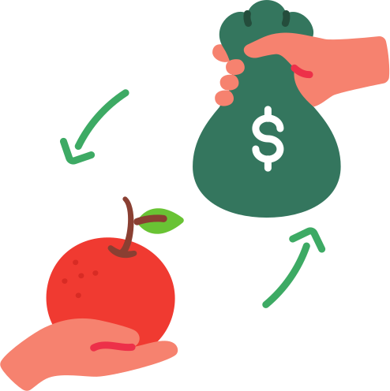
Current Account
The most discussed component of the BOP. The Current Account (CA) is the record of money coming in and out of a country for goods, services, income flows, and current transfers.
Four Components
  Balance of trade in goods
    Imports = money leaving the country; Exports = money entering the country
  Balance of trade in services
    Same as goods.
  Income
    Income citizens receiv from investments abroad such as rent, dividents, etc.
  Current transfers
    Transfers of between countries not dealing with investments or payment such as Foreign Aid, Remittances, sending money home to family, etc.
Copyright Bananaomics

Slide 5
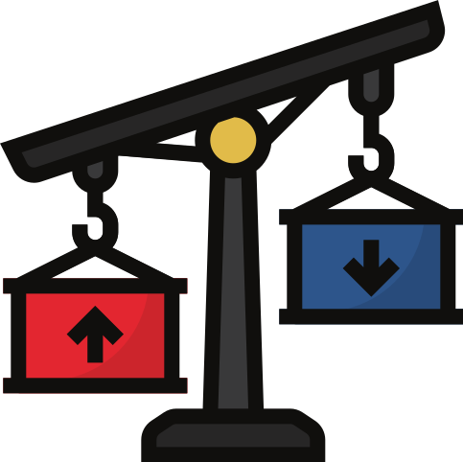
Surplus and Deficit
The main focus when discussing BOP.
  Current Account Deficit
    Exists when the sum of net exports of goods and services plus net income plus net current transfers is negative (or simply when debits or outflows are greater than credits or inflows).
  Current Account Surplus
    Exists when the sum of net exports of goods and services plus net income plus net current transfers are positive (or simply when credits or inflows are greater than debits or inflows).
Copyright Bananaomics

Slide 6


Captial Account
A subaccount of the balance of payments that includes credit and debit entries for nonproduced,
non-financial assets as well as capital transfers between residents and non-residents.
Two Components
  Capital Transfers
    Include financial or non-financial assets for items including debt forgiveness, investment, and non-life insurance claims.
  Transaction in non-production, non-financial assets
    Non-produced assets such as patented entities, leases/apartment rentals or other transferable contracts, and payments of goodwill
Copyright Bananaomics

Slide 7

Financial Account
Records inflows and outflows of portfolio and FDI funds over a period of time, official borrowing and changes in reserve assets.
Four Components
  Foreign Direct Investment
    The purchase of a firm, or part of a firm, by a firm from another country
  Portfolio Investment
    The purchase or sale of financial capital such as stocks, bonds, or currency trading.
  Reserve Assets
    Foreign currencies are held by central banks in reserve. These reserve currencies can be used to adjust exchange rates.
  Official Borrowing
    When a government borrows or lends money to another country. (typically facilitated through IMF World Bank)
Copyright Bananaomics

Slide 8

The Balance of Payments Explained
Money & Macro
Copyright Bananaomics

Slide 9

Practice Categorization
Determine which category each transaction would fall into
Also note which country receives money (credit) vs which loses money (debit)
  An American citizen buys a new Kia from South Korea.
  A Spanish citizen purchases at a shopping mall in Mexico.
  Every month, Mohammed sends half of this Canadian paycheck back to his family in Iran.
  Sam Walton buys 4 million in Chinese stocks.
  Germany's Deutsch Bank pays 2 million in interest to investors from India.
Copyright Bananaomics

Slide 10
Practice Categorization
Determine which category each transaction would fall into
Also note which country receives money (credit) vs which loses money (debit)
  An American citizen buys a new Kia from South Korea.
    Current; Credit - SK; Debit -US
  A Spanish citizen purchases at a shopping mall in Mexico.
    Capital; Credit - Mexico; Debit - Spain
  Every month, Mohammed sends half of this Canadian paycheck back to his family in Iran.
    Current; Credit - Iran; Debit - Canada
  Sam Walton (American) buys 4 million in Chinese stocks.
    Financial; Credit - China; Debit - USA
  Germany's Deutsch Bank pays 2 million in interest to investors from India.
    Current; Money received from investment is Current; Credit - India; Debit - Germany
Copyright Bananaomics

Slide 11

Interdepence Between Accounts
Copyright Bananaomics

Slide 12
Interdependence
Capital Account
BOP
Current Account
0
Financial Account
Copyright Bananaomics

Slide 13

Double Entry
For every recorded entry, there is an equal and opposite entry.
Think about it from the perspective of your own personal checking account.
When you pay money digitally from it, money leaves your account (debit) and is put into another account (credit).
The balance of payments accounts work the same way except in different currencies from different countries.
Copyright Bananaomics

Slide 14
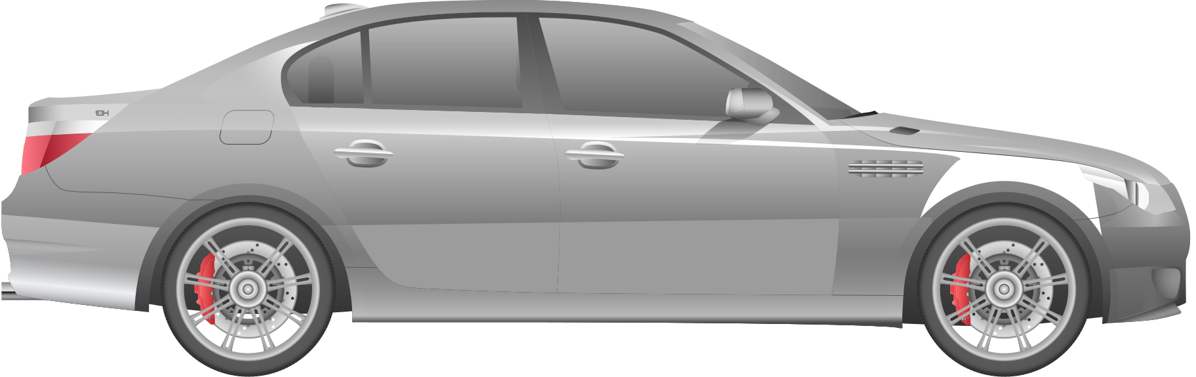
Balance of Payments Example
Assume Americans buy BMW's from Germany for USD 25 000. The American would pay USD 25 000 and BMW in Germany. Germans have no use for USD so they must exchange them for Euros which would be around EUR 23 700.
But for which accounts?
America would receive a debit to its current account.
Germany would receive a credit to its financial account as its only transaction is receiving USD and exchanging them for Euros.
Copyright Bananaomics

Slide 15
Balance of Payments Example
Credits and debits must always offset one another. Balance of payments should always be equal to zero.
Capital and Financial Account
Current Account
+ 25 000 (Surplus)
- 25 000 (Deficit)
Copyright Bananaomics

Slide 16

Current Account & Exchange Rate
(HL ONLY)
Copyright Bananaomics

Slide 17
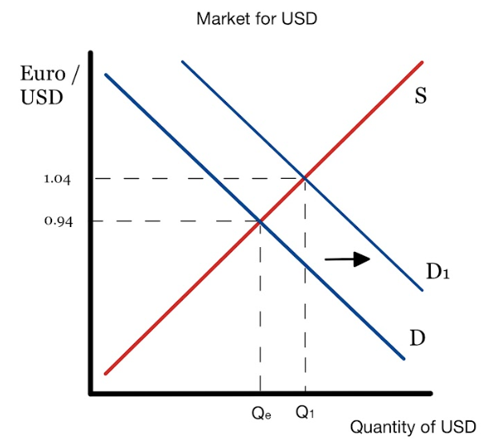
Current Account & Exchange Rate
Current account deficits and surplusses are automatically adjusted under a floating exchange rate system.
Current Account Surplus Example
If a country exports airplanes for example, they receive a current account surplus. As the payment for these planes eventually exchange to USD, this results in increased Demand of USD. (appreciation)
Copyright Bananaomics

Slide 18
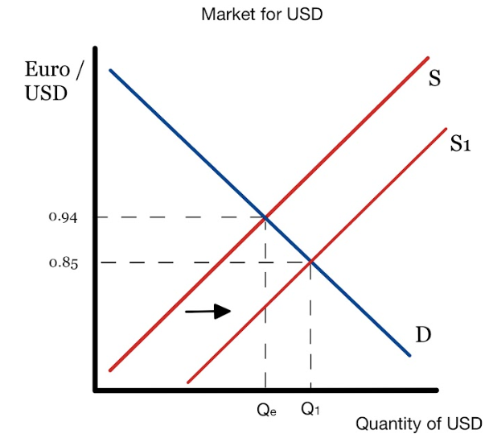
Current Account & Exchange Rate
This appreciation causes exports to appear more expensive and result in a decrease in the demand for exports as consumers will buy planes from other countries.
Copyright Bananaomics

Slide 19
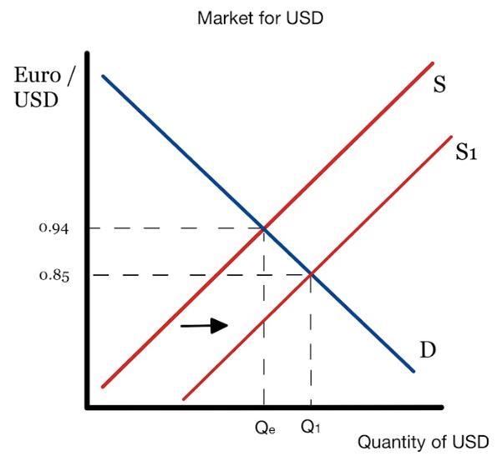
Current Account & Exchange Rate
The same exact scenario occurs for a current account deficit.
A current account deficit means money is leaving your country and the supply of your currency is increasing (Depreciation). Exports now appear to be cheaper leading to an eventual increase in Demand.
Copyright Bananaomics

Slide 20

Financial Account & Exchange Rate
(HL ONLY)
Copyright Bananaomics

Slide 21
Financial Account & Exchange Rate
Uncertainty and interest rates also have the ability to affect the exchange rate.
Financial Account Surplus Example
If US banks offer a higher interest rate than countries in Europe, USD appreciates due to the increase in demand. However, due to appreciation this results in a decrease in demand for exports r and an increase in demand for imports eventually causing the exchange rate to adjust back down.
Copyright Bananaomics

Slide 22

Implications of a Consistent Current Account Deficit
(HL ONLY)
Copyright Bananaomics

Slide 23

Implications of a Persistant Current Account Deficit
  Exchange Rates
    CA Deficit puts downward pressure on a currency's exchange rate. Typically this adjusts back but there are scenarios for countries that import a large number of raw materials where this damages their economy long-term.
  Interest Rates
    CA Deficits can cause increases in interest rates potentially causing a decrease in AD due to a lack of consumption and investment.
  Foreign ownership of domestic assets
    Due to the decrease in the exchange rate, foreign investors may purchase larger quantities of domestic assets, meaning the money will continue to exit the economy.
Copyright Bananaomics

Slide 24

Implications of a Persistant Current Account Deficit
  Debt
    If a country's imports are greater than exports persistently, this can lead to indebtedness
  Credit Ratings
    If a country is unable to service its financial account debt (capital payments on loans), it could receive a downgrade in its credit score.
  Demand Management
    CA deficits must be taken into account by governments attempting to use DS policies as government spending can impact the BOP in a negative way.
  Economic Growth
    If a country's citizens consistently buy foreign products and services, domestic producers receive no revenue and are forced to lay off workers and reduce output.
Copyright Bananaomics

Slide 25
Current Account Deficit Consequences
EconPlusDal
Copyright Bananaomics

Slide 26

Methods to Correct a Persistent Current Account Deficit
(HL ONLY)
Copyright Bananaomics

Slide 27

Methods to Correct a Current Account Deficit
  Expenditure Switching
    The goal is to switch consumption from imports to domestic goods by the use of protectionist measures (tariff, quota, subsidy)
  Expenditure Reduction
    Attempting to slow down the economy, a government may use contractionary demand-side policies to reduce aggregate demand.
  Supply-Side Policies
    If domestic producers are simply uncompetitive or not innovative enough to compete in international markets, supply-side policies should be able to help with a focus on production, efficiency, and R&D.
Copyright Bananaomics

Slide 28

Effectiveness of Methods to Correct a Current Account Deficit
(HL ONLY)
Copyright Bananaomics

Slide 29
Effectiveness of Measures
Expenditure Switching
As this method deals with protectionist measures, the primary factor in the effectiveness will be the elasticity of the good on which the tariff or quota is placed. In order for it to be effective, a country must be able to produce the good domestically.
For example, if Cambodia were to place a tariff on electronic semiconductor chips it would not be effective as Cambodia is unable to produce them domestically due to lack of appropriate technology.
Copyright Bananaomics

Slide 30
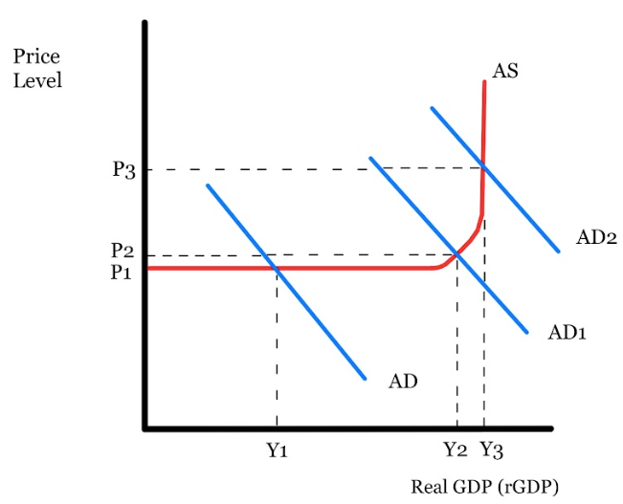

Effectiveness of Measures
Expenditure Reduction
Contractionary Demand-side policies do have the ability to correct a CA deficit. However, too much contractionary policies can lead to a recession and drastic fall in real GDP.
Copyright Bananaomics

Slide 31
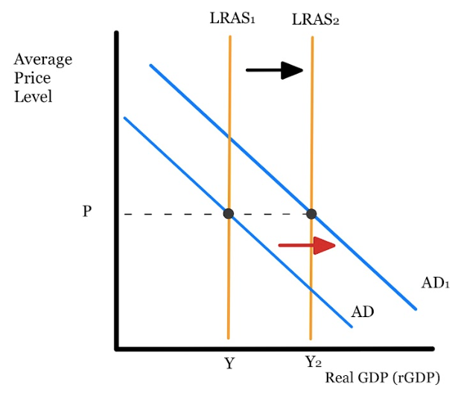
Effectiveness of Measures
Supply-Side Policies
Both expenditure switching and reducing policies don't address the direct issue of why consumers prefer foreign imports over domestic goods. A government may chose to enact SS policies designed to increase efficiency and competition to create better goods and increase export demand.
Copyright Bananaomics

Slide 32
Balance of Payments - Policies to Correct Current Account Imbalances | Economics Revision
tutor2u
Copyright Bananaomics

Slide 33
The Marshall-Lerner Condition &
The J-Curve
(HL ONLY)
Copyright Bananaomics

Slide 34

Definition
Marshall-Lerner Condition
A condition stating that depreciation or devaluation of a currency will lead to an improvement in the current account balance if the sum of the price elasticity of demand for exports plus the price elasticity of demand for imports is greater than one.
Essentially, if the demand of exports and imports are elastic, it's easy to decrease consumer demand for foreign goods and the current account deficit will correct itself and collect a surplus.
Copyright Bananaomics

Slide 35

Its All About Elasticity
Essentially, if the demand of exports and imports are elastic, it's easy to decrease consumer demand for foreign goods and the current account deficit will correct itself and collect a surplus.
The same is true for the opposite. If the demand for exports and imports is inelastic, a current account deficit may continue to worsen and further depreciate currency.
Copyright Bananaomics

Slide 36

Definition
The J-Curve Effect
Following devaluation or a sharp depreciation, a trade deficit will typically widen before it starts improving thus tracing the letter “J” if plotted against time, because the Marshall-Lerner condition is satisfied only after a period of several months following the decrease value of the currency.
In simple terms, it takes time for a current account adjustment to take place.
Copyright Bananaomics

Slide 37
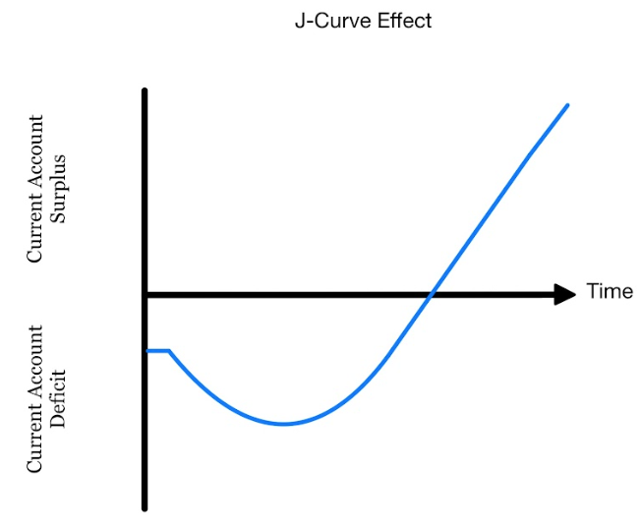
Diagram
It takes time for consumers to adjust to new prices.
Copyright Bananaomics

Slide 38
Implications of a Consistent Current Account Surplus
(HL ONLY)
Copyright Bananaomics

Slide 39
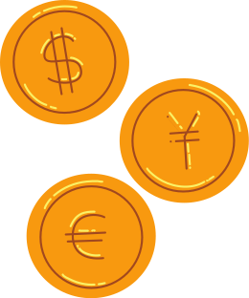
Implications of a Persistant Current Account Surplus
CA surplus occurs only when imports are decreasing and exports increasing.
Domestic Consumption and Investment
    During a recession, consumers may import less or exports may be more attractive.
Exchange Rates
    CA surplus leads to appreciation. Eventually, this decreases exports as they appear more expensive and an increase in imports as the domestic currency is now stronger.
Inflation
    Due to an increase in exports, AD typically increases potentially causing inflation.
Copyright Bananaomics

Slide 40
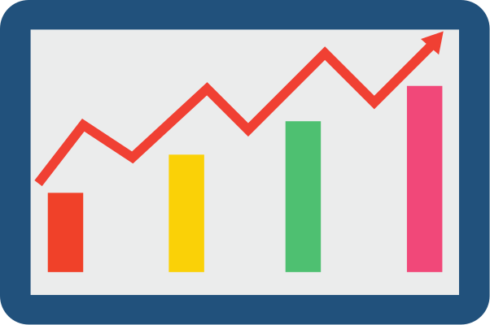
Implications of a Persistant Current Account Surplus
CA surplus occurs only when imports are decreasing and exports increasing.
Employment
    As increasing exports cause AD to increase, the quantity of employed typically increases.
Export Competitiveness
    CA surplus leads to appreciation. Eventually, this decreases exports as they appear more expensive.
Copyright Bananaomics

Slide 41

Practice Question
Copyright Bananaomics

Slide 42
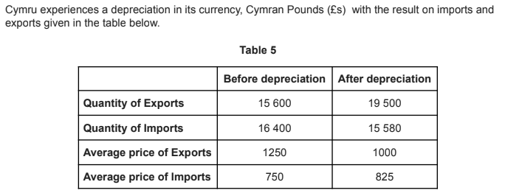
Mock/22/ECONO/HP3/ENG/TZ0/XX
Paper 3
Copyright Bananaomics

Slide 43
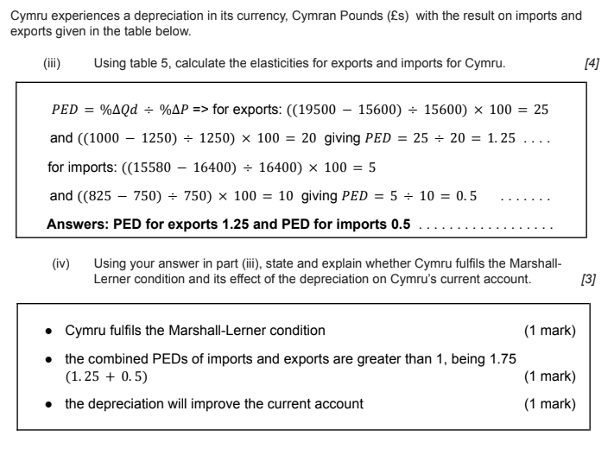
Mark Scheme
Copyright Bananaomics

Slide 44
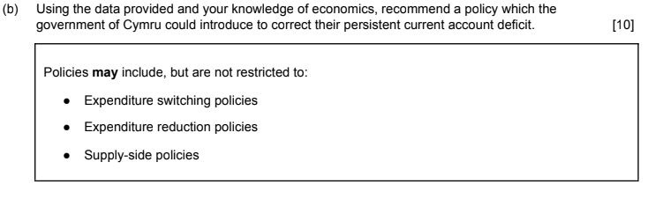
Mark Scheme
Copyright Bananaomics

Slide 45

Enjoying The Content?
Visit bananaomics.com to purchase package deals with discount prices!
BANANAOMICS

